Slide 1
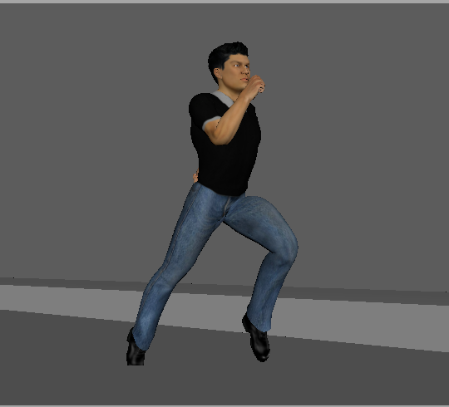
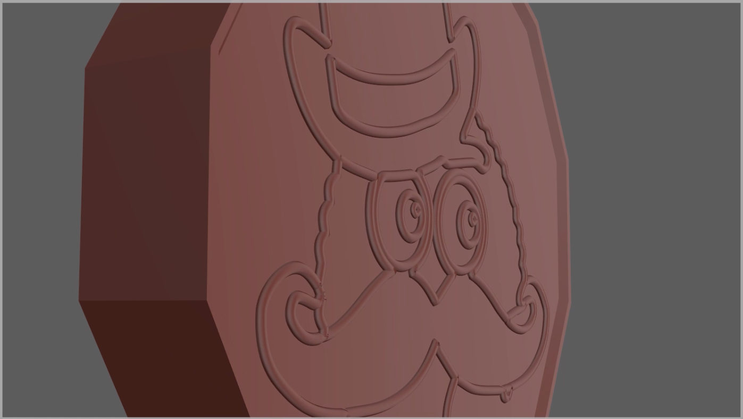
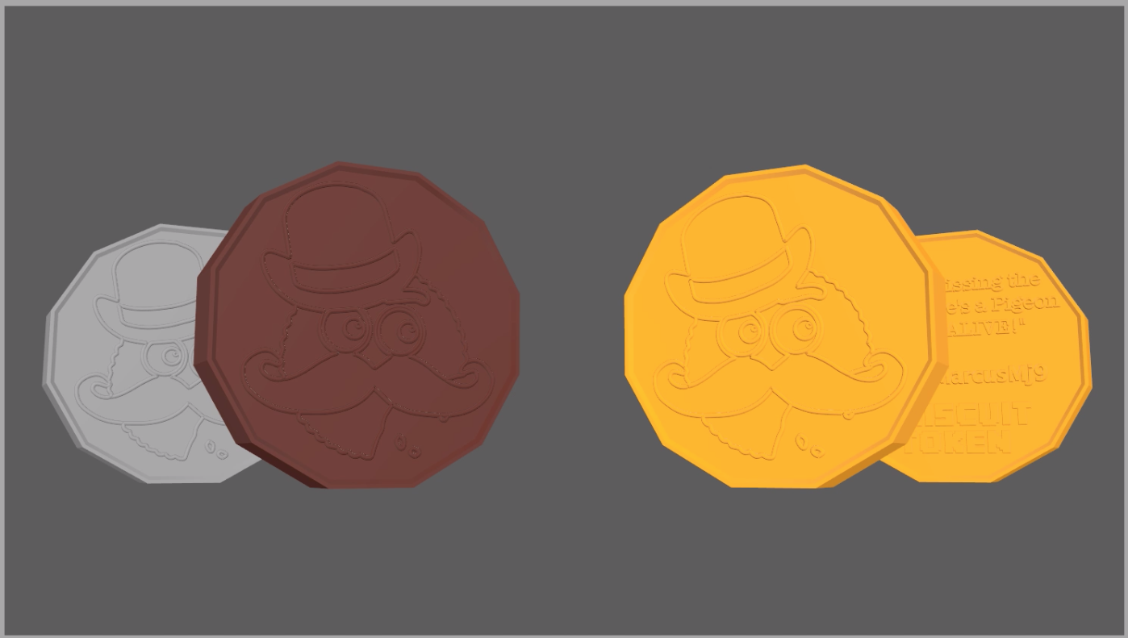
MARCUS AYRTON
3D Previs for films/advertising

Slide 2
PRE-VIS QUALITIES
Consistencies within the role:
Composition
Cinematography and movement
Editing
Visual storytelling
Knowledge of Unreal Engine
Creativity
Knowledge of Maya + Other new upcoming software
GENERAL AIMS: To improve upon these skills with small scale projects.
Such as practising rendering basic character animation using 'Unreal Engine', and testing out different stylistic camera angles to convey different messages.(Eg an action scene, drama, an advert)

Slide 3

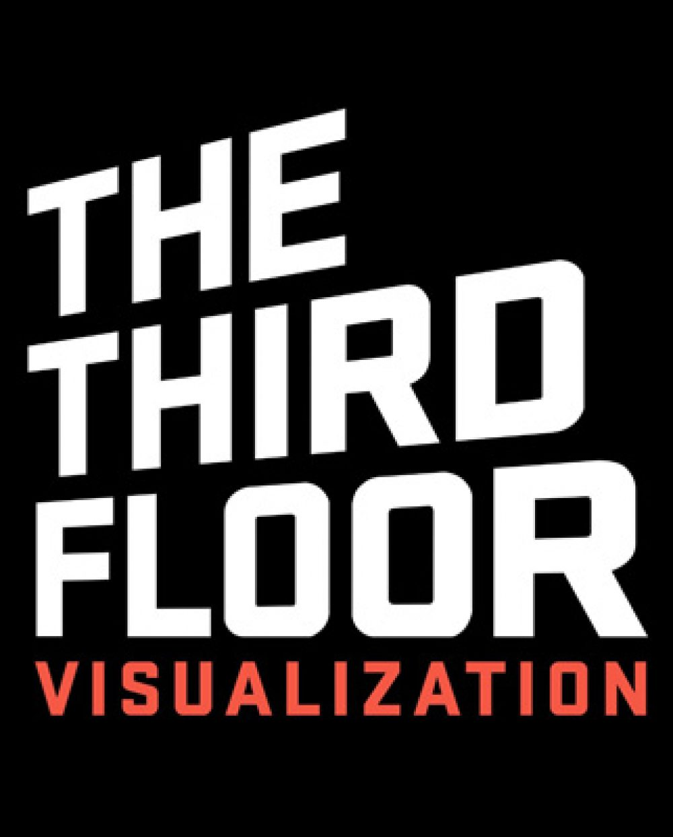

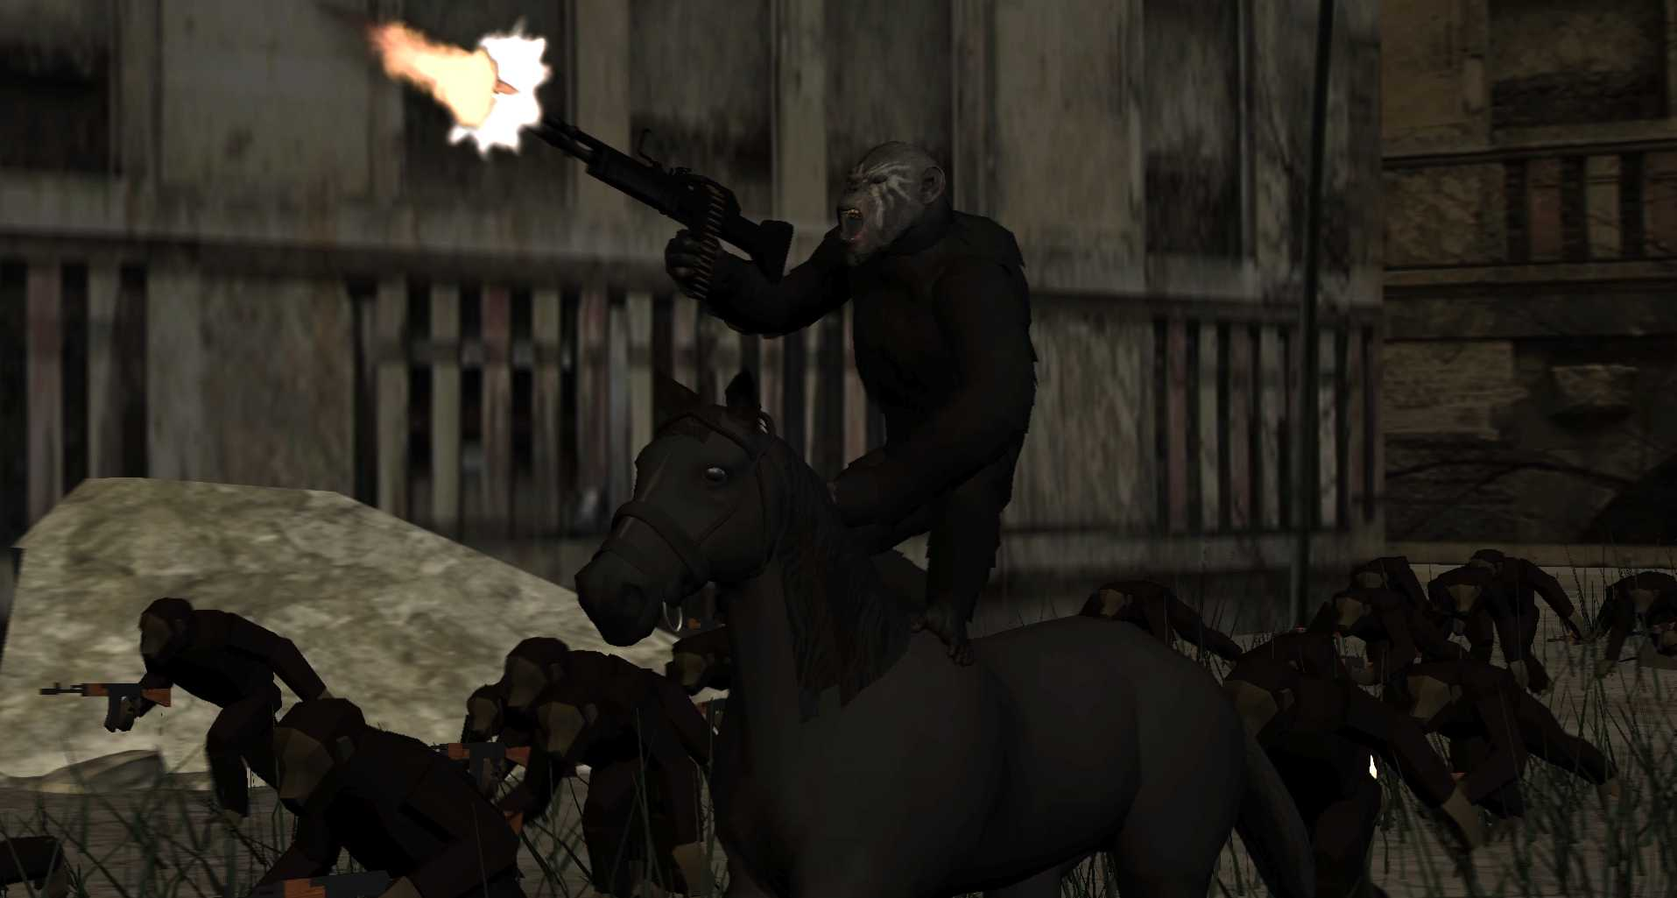
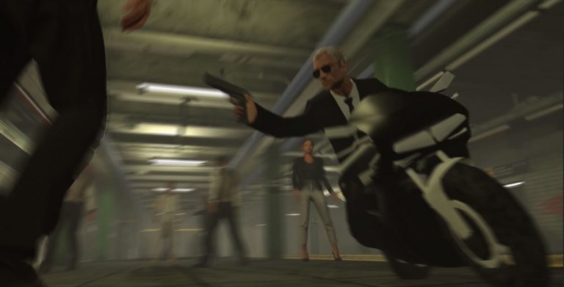
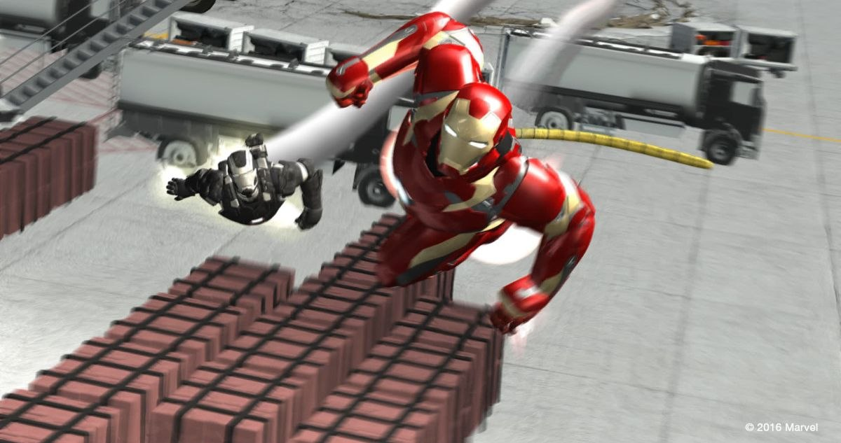
COMPANIES TO ASSOSCIATE WITH
All have a very similar style for previs action sequences. All use MAYA
All industry is moving to unreal, but DNEG is officially part of the pipeline
Third Floor use Adobe suite also (After Effects)
MPC use propiartary software, as well as Houdini for VFX
Three different companies previs, all the same animaition style, art style, etc

Slide 4
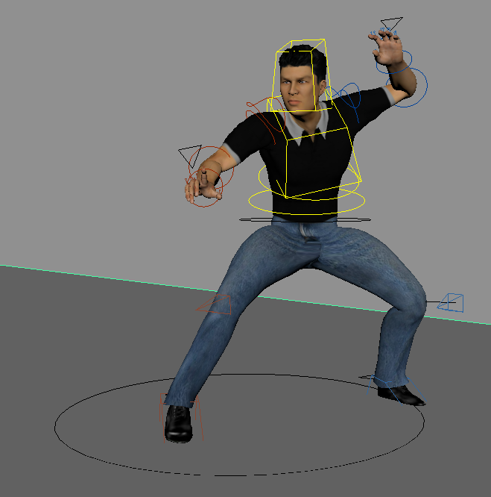
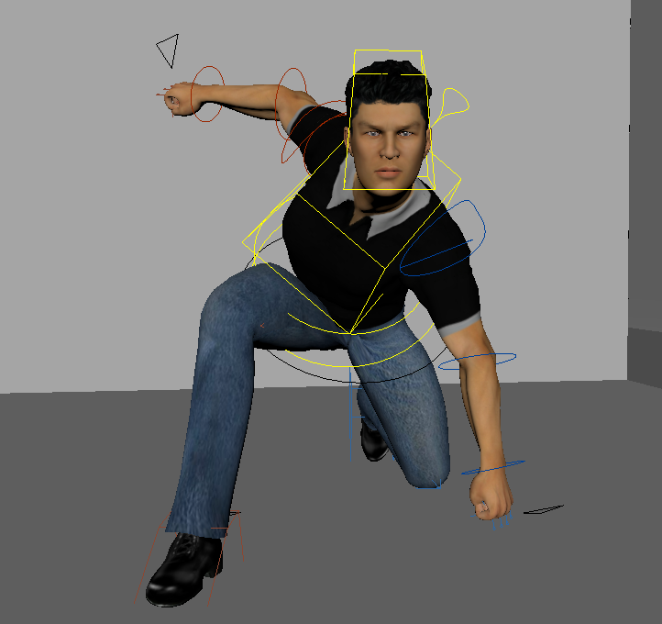
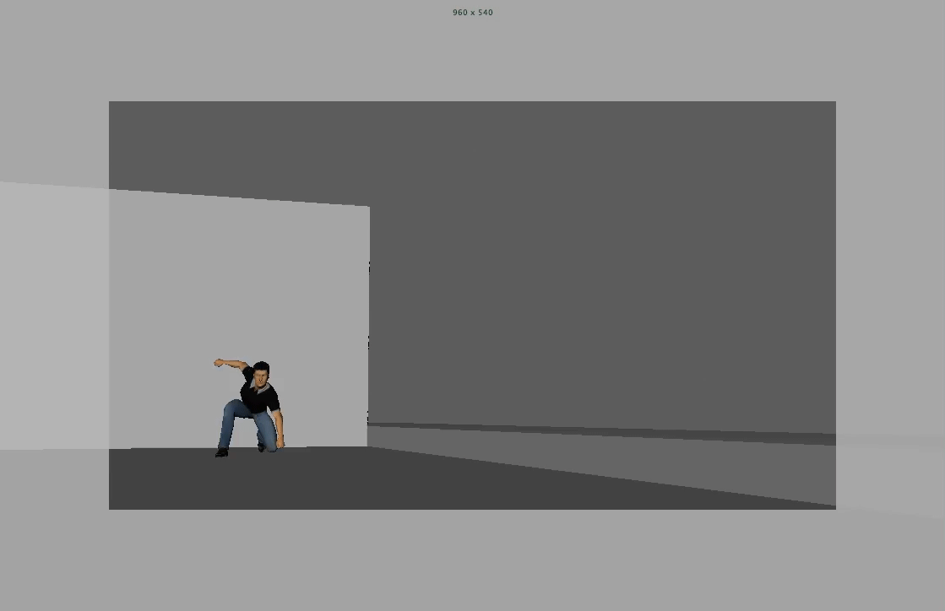

PROJECT: MIXAMO TEST
Design – Bring to maya – Remove Skeleton – FBX mesh into mixamo – Create Rig – Back into maya – Use plugin to create control rig
Created a character using Autodesk Character creator and used an industry standard workflow to quickly create a working control rig. Perfect for quick character creation for pre-vis.
Did some posing, and some animation to test the rig. Rig is perfectly functional and great for basic animations, but it's not very advanced, and Mixamo doesn’t do facial rigs.

Slide 5
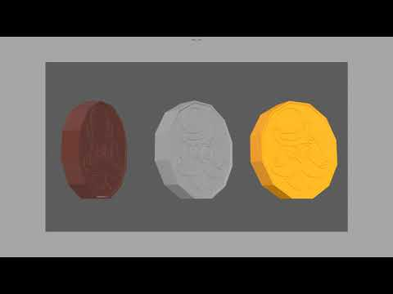
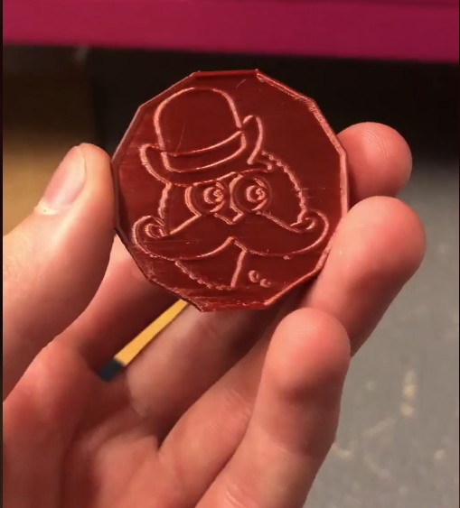



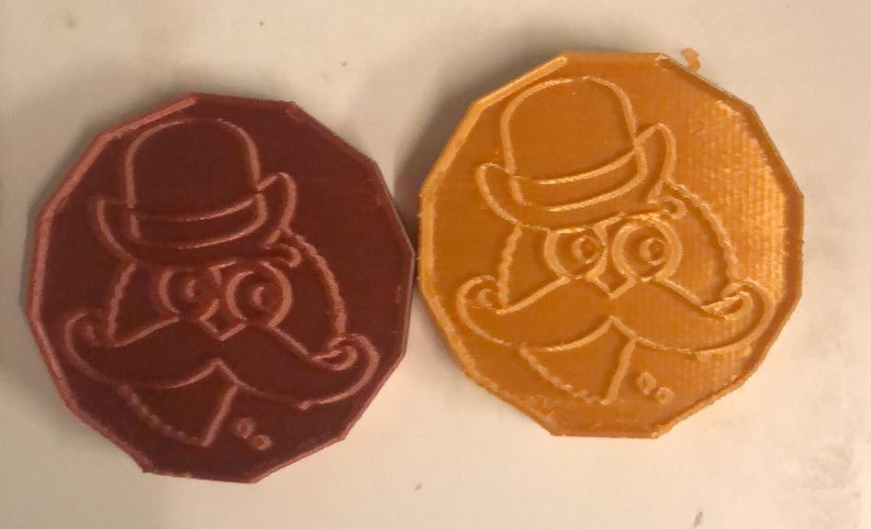
PROJECT: 3D ADVERT PREVIS
Created an Apple style promotional video for a 3D modelled Token I have designed for a discord server.
3D Model – Took a Vector file created in Adobe illustrator, converted it to curves and then polygons using a built-in tool. The "Biscuit Mafia" logo from discord was autotraced before vectorising into a simple outlined shape, which maya would recognise.
Using Mesh Mixer, these OBJ files would then be converted to STL, ready for 3D printing.
Advert - A chance to experiment more with camera angles and movements, taking inspiration from multiple apple iphone promotional videos. The music which I created for it, also took heavy inspiration from it too. Using camera sequencer, I edited it to the soundtrack. Currently in the process of texturing and rendering...potentially something to try in unreal?

Slide 6
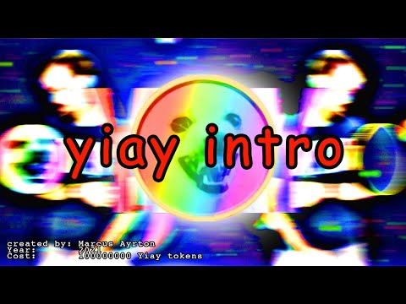
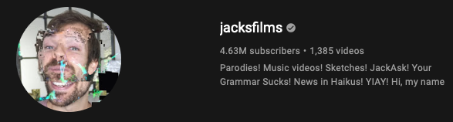

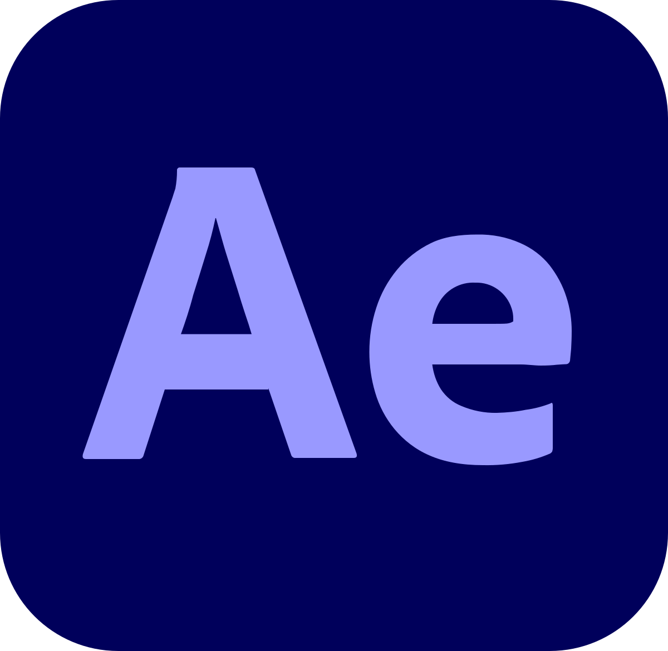

PROJECT: JACKSFILMS INTRO CONTEST
My entry:
Does regular competitions, in which he picks his favourite responses and features them in his popular videos for his "YIAY" series. There are never official winners, and no official prizes. He does award semi real grades and sometimes awards fictional "Yiay Tokens".
This competition was
"Make me an intro!"
His aim for this is to gain funny parody responses, featuring references to his brand, fanbase, other popular content.
Skills used:
3D After Effects skills using Element 3D plugin.
Very basic texture mapping, creating traced 3D model from image, After effects lighting, Rotoscoping, Audio Sync, 3D video layers,
Gains:
The entry was featured being the only 3D entry. It was awarded the highest "SSS" Grade, and awarded me 500,000,000 Yiay tokens, the highest he's ever given out.
Gained over 600 extra youtube subscribers, on top of the already 1400 I gained from a similar competition I took part in last year, except for video editing.

Slide 7

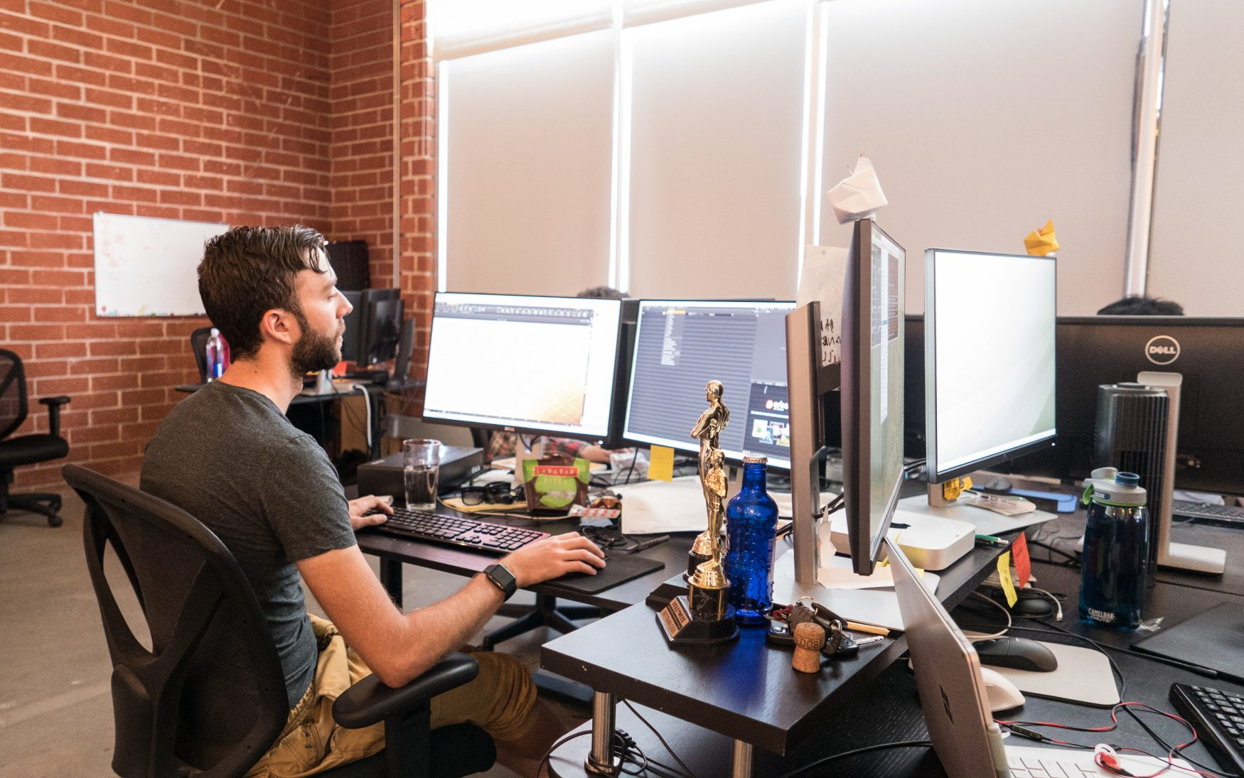
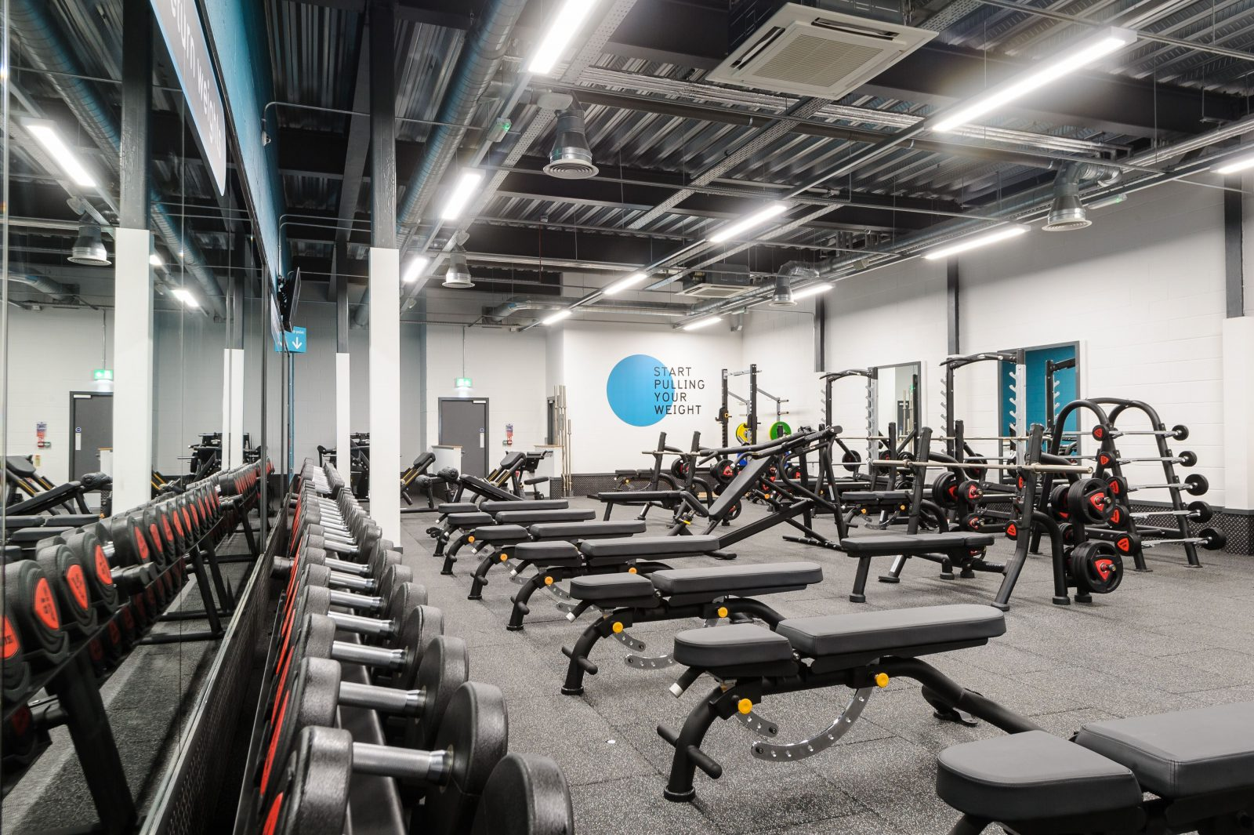
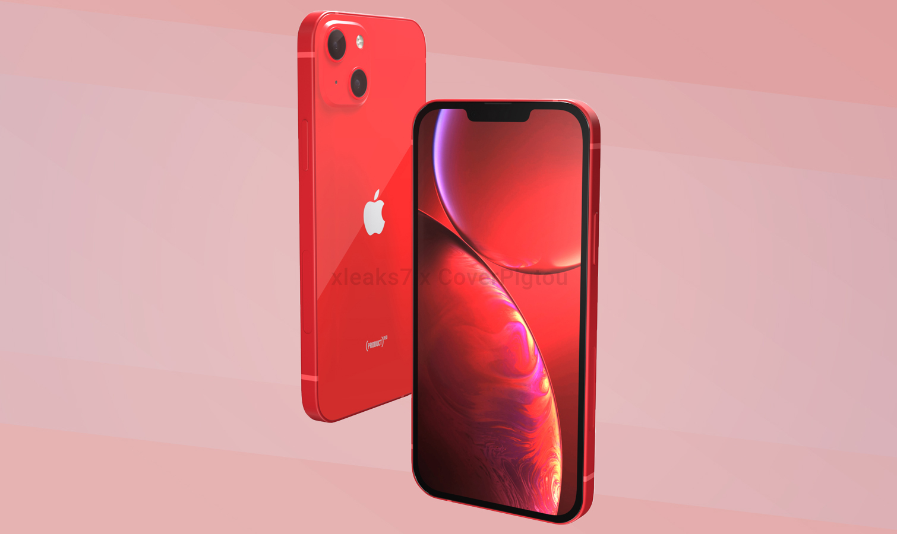
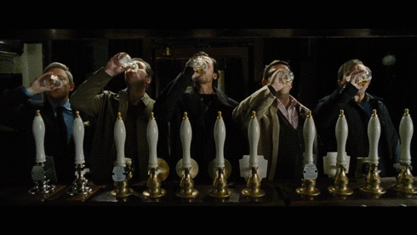

My goals summarised
EDUCATION
UNREAL ENGINE:
Render in Unreal Engine, Single premade object and an image render. Then try and import pre done Mixamo animation.
CAMERA EDITING
A very short animated story. Use cameras to tell the story in different cinematographers/ editors styles and techniques (Eg, Edgar Wright, Michael Kahn, Walter Merch, )
LIGHTING AND RENDERING
A lighting / rendering project with my biscuit token animation. Chance to focus entirely on testing out lights and scenery. Rendering with Arnold.
PERSONAL
MENTAL HEALTH:
Summer has been filled with hardship, loss, difficulty, covid, self discovery. Gaining a psych assessment through the university very soon for ADHD, as well as on the path of Grief Recovery and Hopefully referral for some form of counselling.
PHYSICAL HEALTH:
Want to be back into the swing of gym twice of week, with maybe other fitness aims. I'm not far behind by any means, but simply doing gym twice a week has been very difficult.
INDUSTRY
MOVESTREETS:
I have an upcoming motion graphics job with them. Done work before, but this is directly through them after a recommendation.
STUDIO VISITS
Would love to eventually have a studio visit. They have been cancelled because of covid, so as soon as they are open, I want to check them out. Either at DNEG or Third Floor (preferably DNEG cause of previous contacts)
ADVERTISING
With my recent delve into advertising, would love to explore the pre vis side of it, currently am completely clueless
BUILD UP CONTACTS
Through linkedin, uni and other sources, would love more of a contact base to be able to have options when entering industry.

Slide 8
My goals UPDATED
EDUCATION
UNREAL ENGINE:
Render in Unreal Engine, An image sequence or movie sequence testing out rigs
CAMERA EDITING
A very short animated story. Use cameras to tell a premade story in different cinematographers/ editors styles and techniques (Eg, Edgar Wright, Michael Kahn, Walter Merch, ) Do multiple edits to show different distinct editing styles, and then get personal feedback on which one works better. Each style can be based off particular directors/editors.
PERSONAL
MENTAL HEALTH:
Summer has been filled with hardship, loss, difficulty, covid, self discovery. Gaining a psych assessment through the university very soon for ADHD, as well as on the path of Grief Recovery and Hopefully referral for some form of counselling.
PHYSICAL HEALTH:
Want to be back into the swing of gym twice of week, with maybe other fitness aims. I'm not far behind by any means, but simply doing gym twice a week has been very difficult.
INDUSTRY
MOVESTREETS:
I have an upcoming motion graphics job with them. Done work before, but this is directly through them after a recommendation.
STUDIO VISITS
Would love to eventually have a studio visit. They have been cancelled because of covid, so as soon as they are open, I want to check them out. Either at DNEG or Third Floor (preferably DNEG cause of previous contacts)
ADVERTISING
With my recent delve into advertising, would love to explore the pre vis side of it, currently am completely clueless
BUILD UP CONTACTS
Through linkedin, uni and other sources, would love more of a contact base to be able to have options when entering industry.

